Slide 1
Project Requirements (internship guide project)

Slide 2
1)Use Cases Overview
Definition:
A scenario-based technique in UML (Unified Modeling Language) used to identify actors and describe interactions within the system.
Purpose:
To define system boundaries.
To identify functional requirements and organize system design

Slide 3
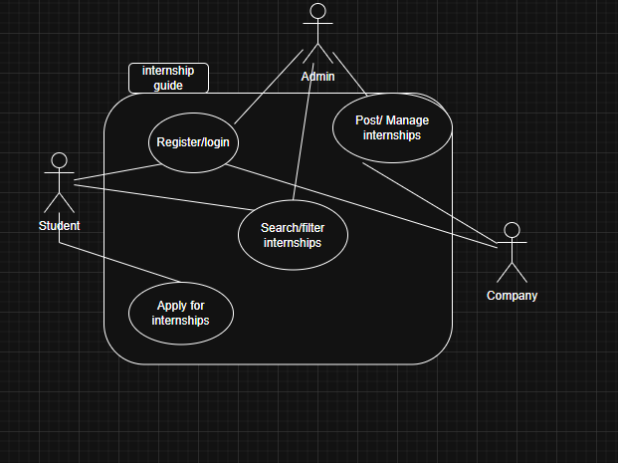

Slide 4
A) System Requirements
To bring the internship portal to life, certain system and technical needs must be met. These include the basic hardware and software required for development, as well as tools needed to run the platform smoothly for users.

Slide 5
1. Hardware Requirements: A typical computer with enough processing power and at least 8GB of RAM is needed to run development tools and manage data efficiently. Storage space should also be sufficient to hold website files, user accounts, and training program data.
2. Software Requirements: The system is being developed using HTML, CSS, JavaScript, and MySQL. It can be built and hosted on any common operating system like Windows, macOS, or Linux. Development will be done using tools like Visual Studio Code for coding, along with a web server like XAMPP or Apache for local testing. Popular web browsers such as Chrome, Firefox, Safari, and Microsoft Edge will be used to test compatibility and design responsiveness.
3. Web Technologies: The platform will rely on front-end technologies (HTML, CSS, and JavaScript) to create an interactive and responsive user experience. Backend logic and data handling may involve languages like PHP or JavaScript (Node.js), while MySQL will manage the storage and retrieval of data.
4. Hosting and Network: The website will need to be hosted on a server that allows internet access for users, such as a cloud service or university server. Internet access is also required to keep users connected and to enable real-time interaction with stored data.

Slide 6
B)User Requirements
To make the platform valuable and accessible for both students and companies, we’ve outlined the key features and expectations users will have when interacting with the system.

Slide 7
1. Easy Account Management: Students and companies need a simple way to register, log in, and manage their accounts securely.
2. User-Friendly Interface: The platform should be clean and intuitive so that users with different technical backgrounds can easily navigate and use it without needing training.
3. Smart Search and Filtering: Students should be able to quickly find internships that match their field of study or interests using smart search tools and filters.
4. Detailed Program Listings: Each training program posted by a company should include all relevant information, like whether it’s paid or unpaid, the field, duration, and eligibility criteria.
5. Accessibility and Device Compatibility: The platform must work well on different devices (laptops, tablets, smartphones) and be accessible to users with different needs, including those with disabilities.

Slide 8
C) Functional Requirements
This section outlines the key features and capabilities that the portal needs in order to function as intended.

Slide 9
1. Account Creation and Login: Both students and companies should be able to sign up and log in securely.
2. Internship Program Management: Companies must have access to a dashboard where they can post new training opportunities, update existing ones, and manage applications.
3. Student Preferences and Recommendations: Students can input their academic major and training preferences to get internship suggestions that match their interests.
4. Data Management: All user and training data will be stored in a structured format using MySQL. This includes company profiles, student accounts, and internship listings.
5. Multi-Page Navigation: The site will be organized into several pages — such as home, login, dashboard, and listings — to make navigation easy and keep the interface clean.

Slide 10
d)Data Requirements Data to be Stored: Student profiles (name, major, skills). Company profiles (name, industry, contact info). Internship details (title, duration, paid/unpaid, eligibility). Application records (student ID, internship ID, status).

Slide 11
E) Non-Functional Requirements
Besides the core features, the system must also meet some important expectations around performance, privacy, and reliability.

Slide 12
1. Security: User information must be protected through secure login systems and encrypted data storage.
2. Performance: The website should load quickly and respond well, even when there are many users online.
3. Accessibility: Design choices should follow accessibility standards, ensuring everyone can use the platform without barriers.
4. Scalability: As more users join or more features are added, the system should be able to grow without needing a complete rebuild.
5. Reliability: The platform should stay online with minimal downtime and should recover gracefully from any issues.
6. Usability: The interface should be intuitive so users can learn to use it quickly, even without tutorials.
7. Compatibility: It should work well across different devices and browsers to give a consistent experience to all users.
8. Data Privacy: User data must be handled responsibly, in line with privacy standards, and without exposing sensitive information.
9. Monitoring and Logging: Basic logging of user actions (e.g., logins, post creation) should be in place to help track performance and support maintenance.
10. Documentation: Clear instructions and guides should be provided for both students and companies to help them understand how to use the platform effectively.

